Slide 1
Waveform visualizer
Jonel Roman
Brian Hoepelman
Group #9
Dr.

Slide 2
TABLE OF CONTENTS
The UI Manager and its functionality
The Waveform Visualizer

Slide 3
Goal of project
To develop an interactive music visualizer that provided a visual representation of audio playback!
Also to provide a user-interface that could control the audio that is being played.
Allow the user to use different forms of audio formats (MP3, WAV, OGG, FLAC, AND AIFF) and intuitive user controls.

Slide 4
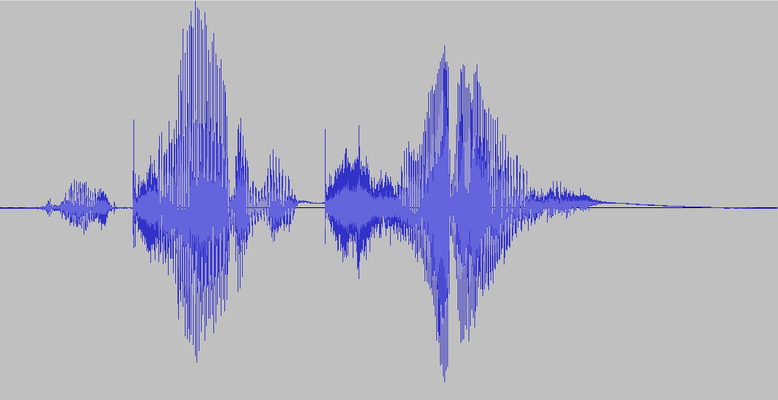
How come this project?
We were inspired to create a visualizer to enhance the music-listening experience!
We wanted to challenge ourselves in creating something unique.

Slide 5
SOFTWARE Requirements
Dear ImGui: A bloat-free graphical user interface library for C++.
SFML: A simple to use and portable API written in C++. A complete multimedia library full of features to build video games or multimedia software.
NativeFileDialog-Extended: A tiny, neat C library that portably invokes native file open, folder select and save dialogs.
ImGui-SFML: A binding library that integrates Dear ImGui with SFML.

Slide 6
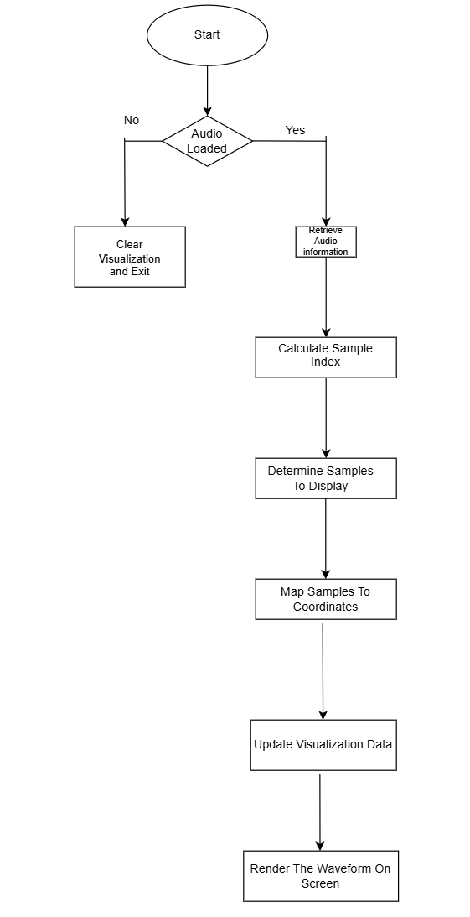
FLOWCHART

Slide 7
Conclusion
Creating this application was both challenging and rewarding. It helped us advance our technical skills with C++, SFML, ImGui, and NativeFileDialog. Learning how to work with audio files allowed us to create something that at the time thought it was out of the realm. Despite the challenges, we overcame adversity and are proud to showcase our creation.

